Slide 1
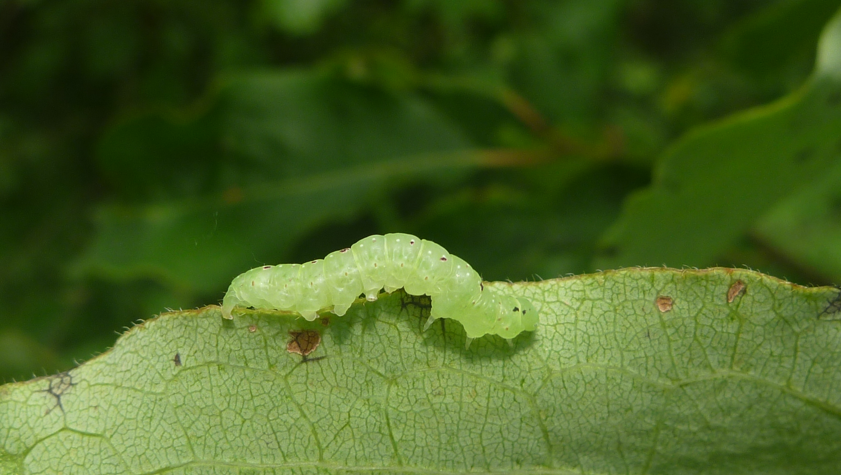
Caterpillars Count!
CITIZEN SCIENTISTS TRACKING THE PHENOLOGY OF BIRD FOOD
https://caterpillarscount.unc.edu

Slide 2





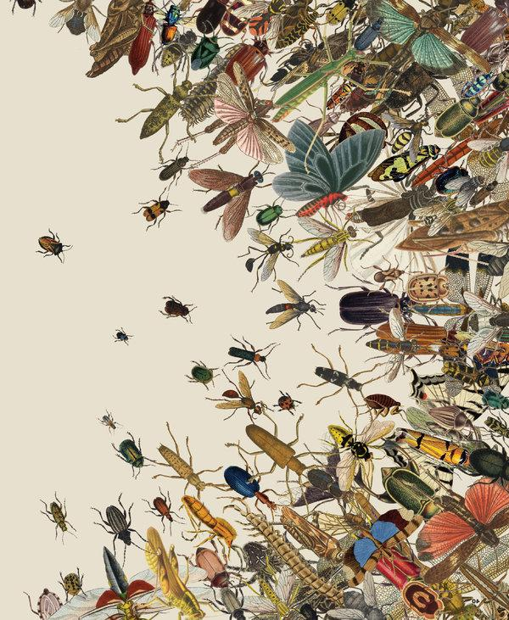
Nov 27, 2018
Dirzo et al. 2014, Science 345: 401
Notes:
Humans have impacted the globe resulting in changes in climate, urbanization, and land cover. These various facets of global change may be impacting biodiversity and ecosystems.
There are alarming reports from around the world that insects may be declining, a phenomenon some have referred to as the “Insect Apocalypse”.

Slide 3
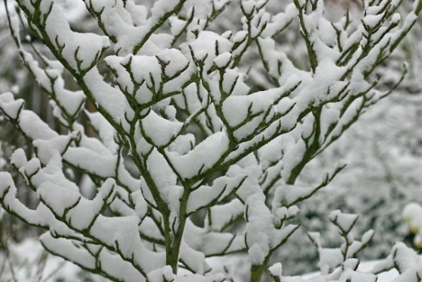
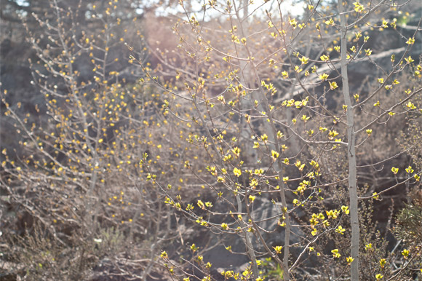
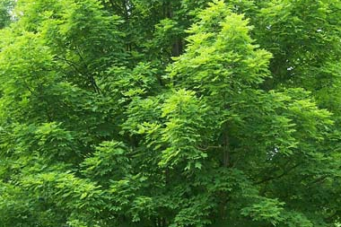
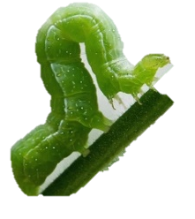
January
April
June
Notes:
In addition to potential declines, warming may also be resulting in a shift in the seasonal timing of insect activity.
For example, many caterpillars only emerge once trees have leafed out in the spring. But as trees have begun to leaf out earlier in areas that have experienced warming, are the insects coming out earlier as well?

Slide 4
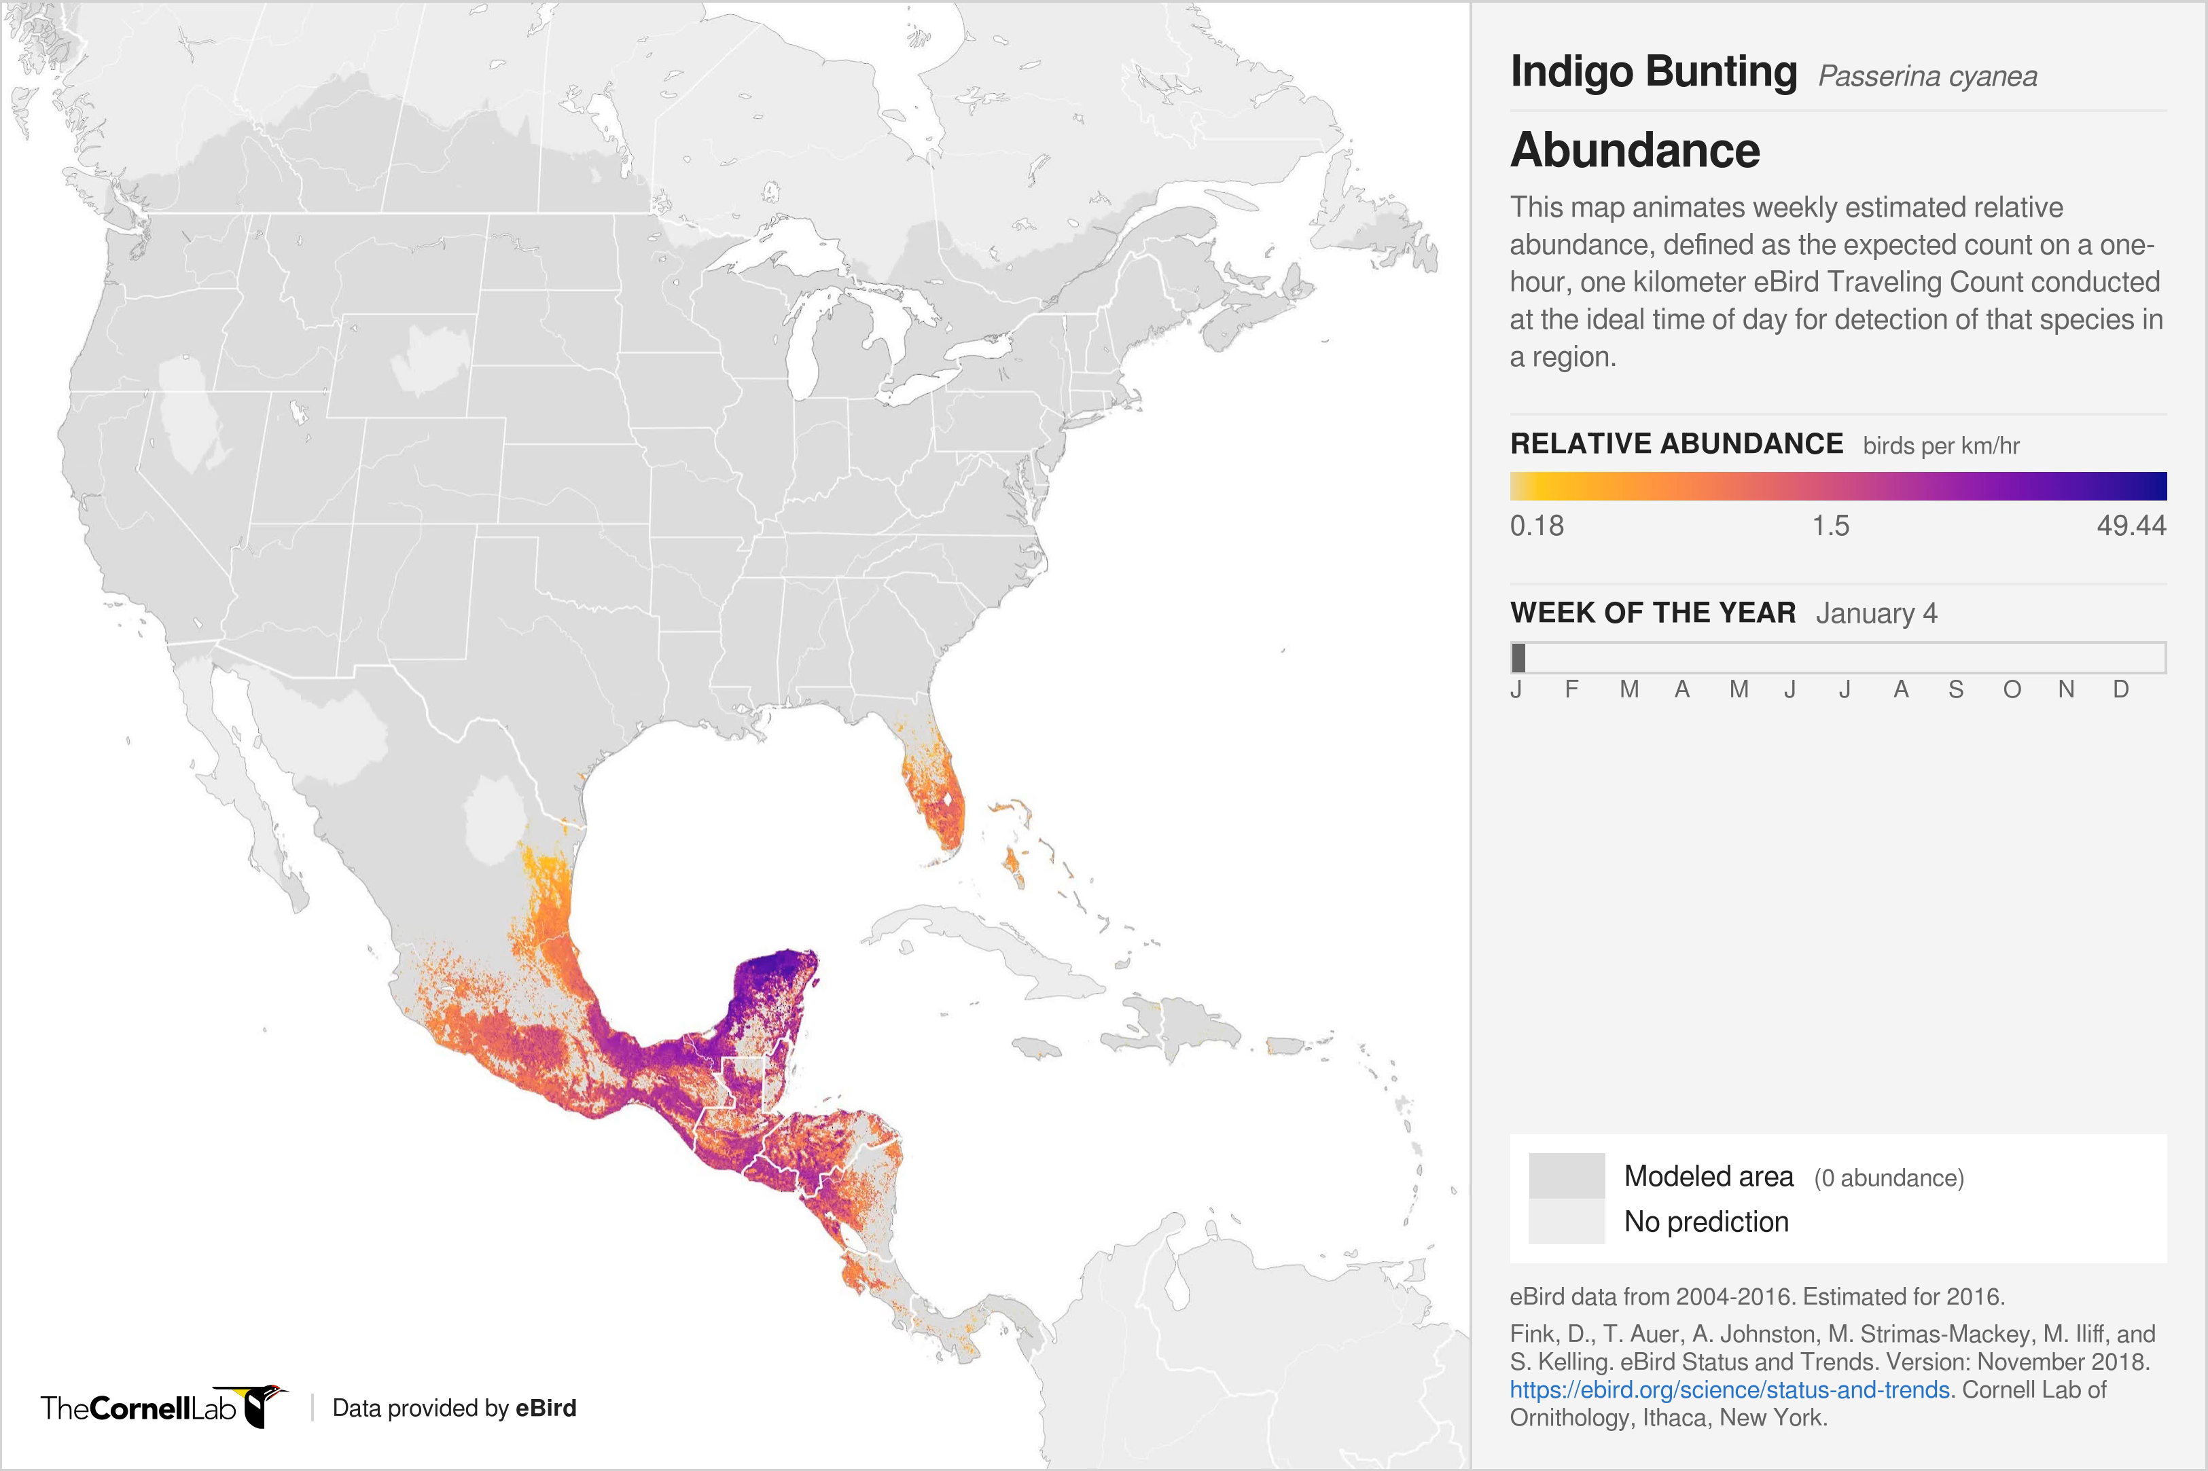
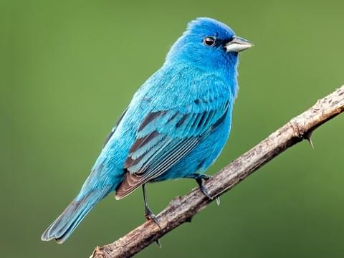
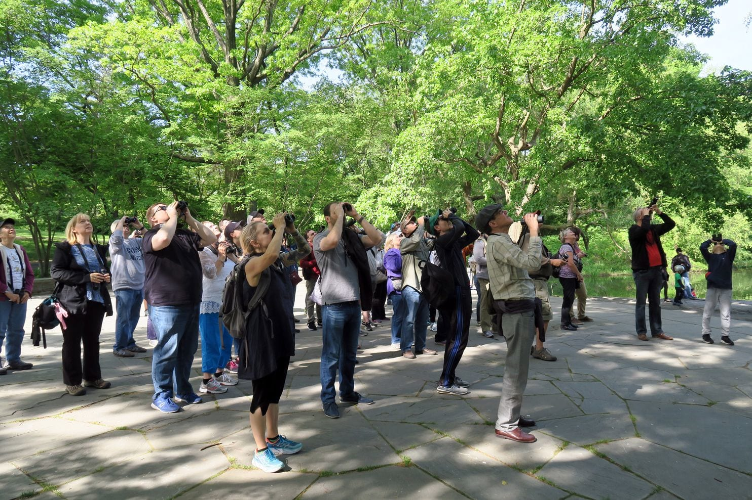
Notes:
If so, this could have impacts on other organisms like birds that rely on those insects as a food resource. This indigo bunting spends the winter in Central America, and times its migration north to breed so that by the time it has young in the nest, there will be plenty of insect food around for it. We have a great sense of the timing of migration for different bird species thanks to citizen science platforms like eBird that aggregate the observations of amateur birdwatchers.
If insects are now peaking in activity earlier than they used to, migrating birds like the indigo bunting may not have enough food to successfully raise all of their young.

Slide 5
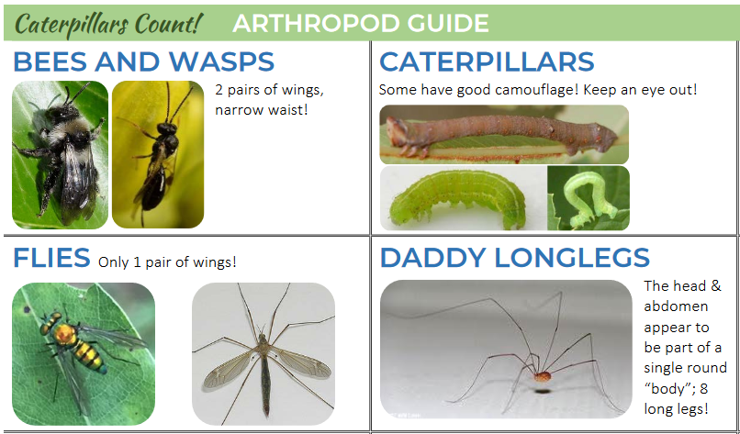
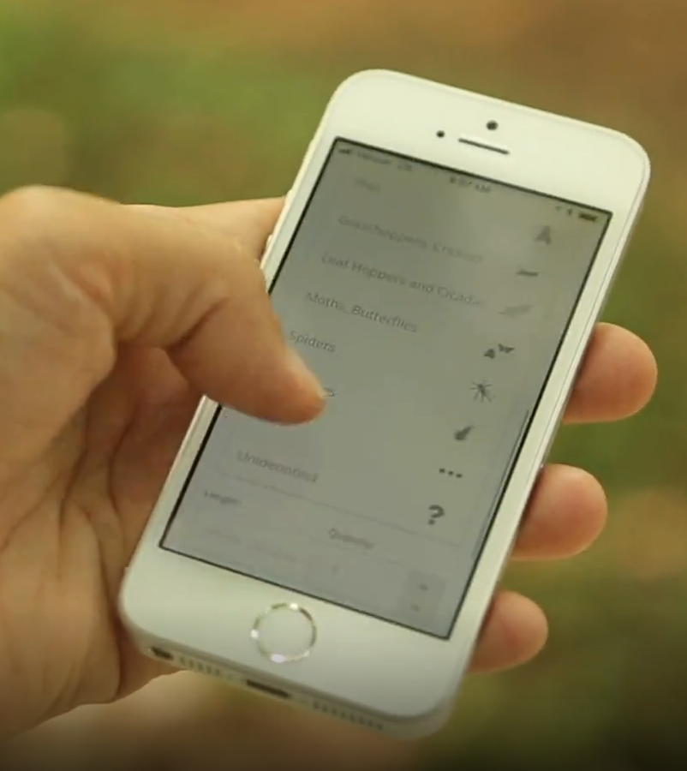
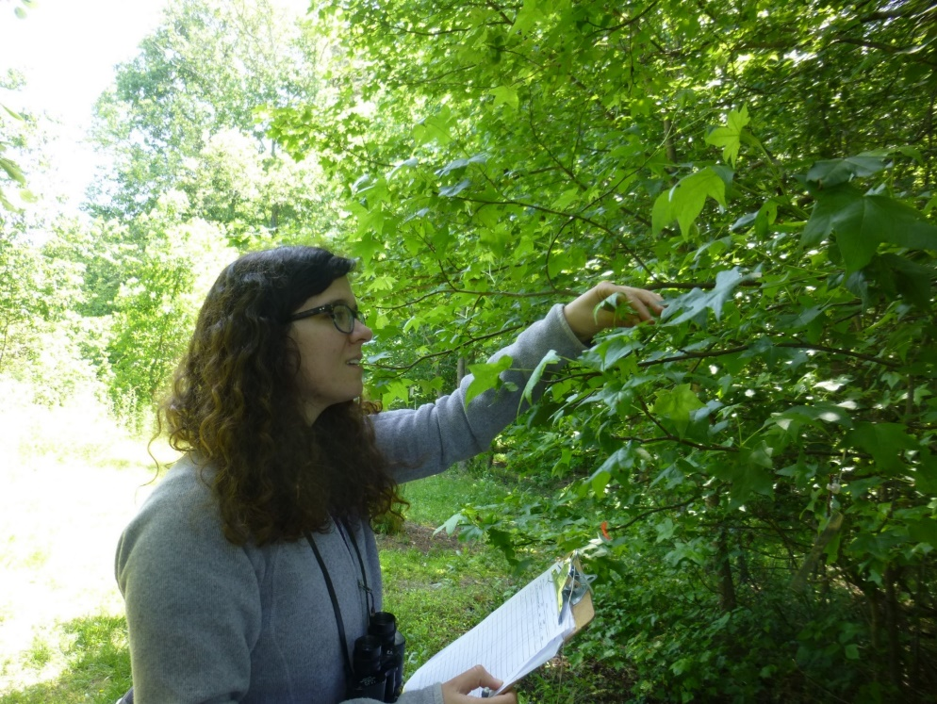
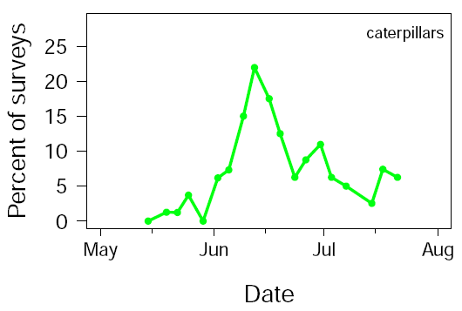

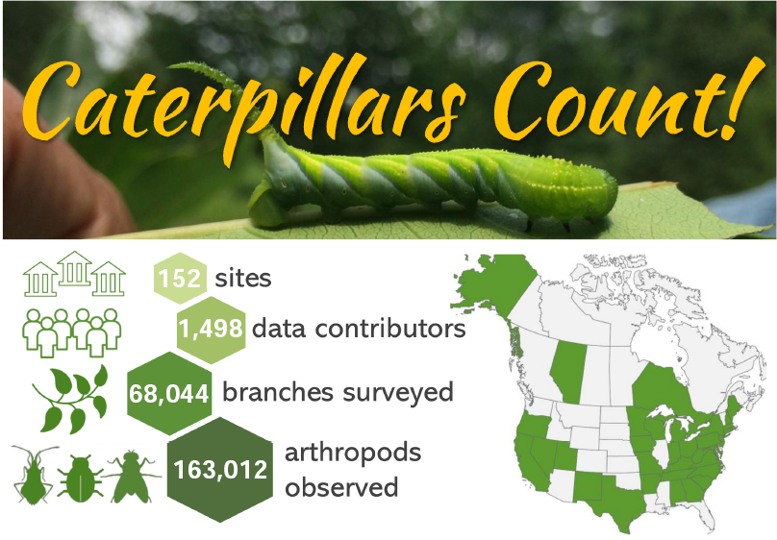
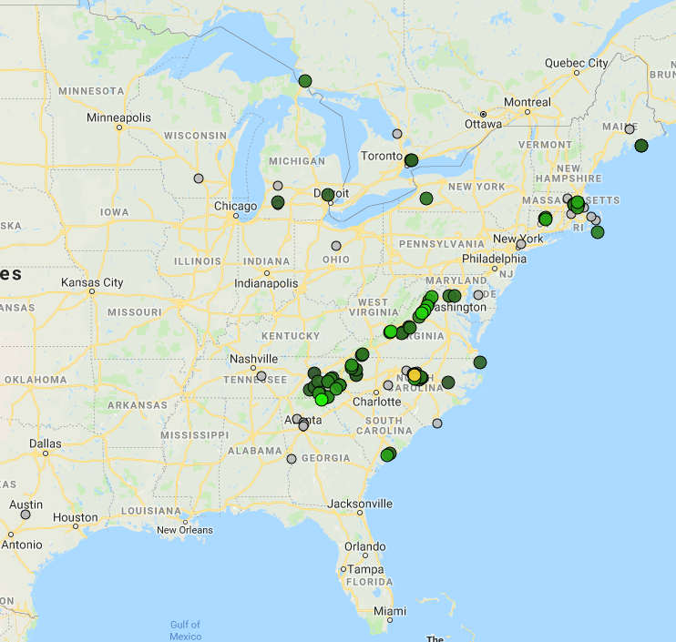
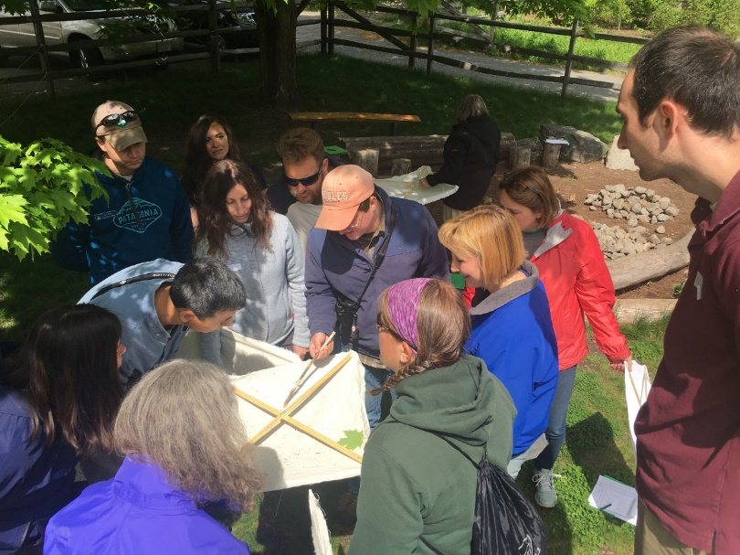
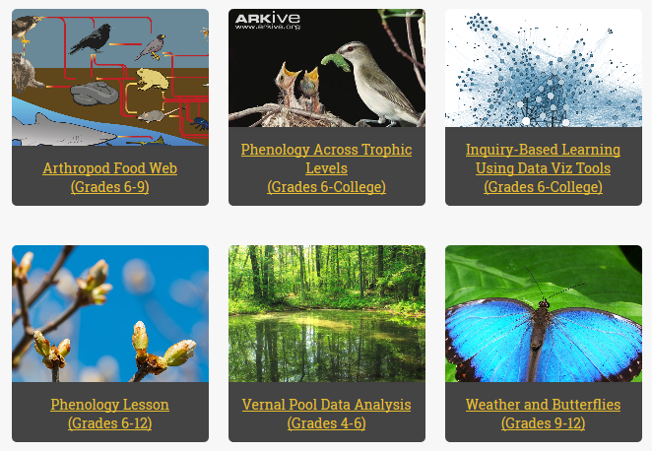
Training resources / mobile app
Conduct surveys
Data visualization tools
Peak date:
June 12
integration
caterpillarscount.unc.edu
Join us!
Nature centers /
school groups
Learning activities
Notes:
Caterpillars Count! was created to better understand trends in arthropod abundance and shifts in seasonal timing all around the world (but mainly North America for now).

Slide 6
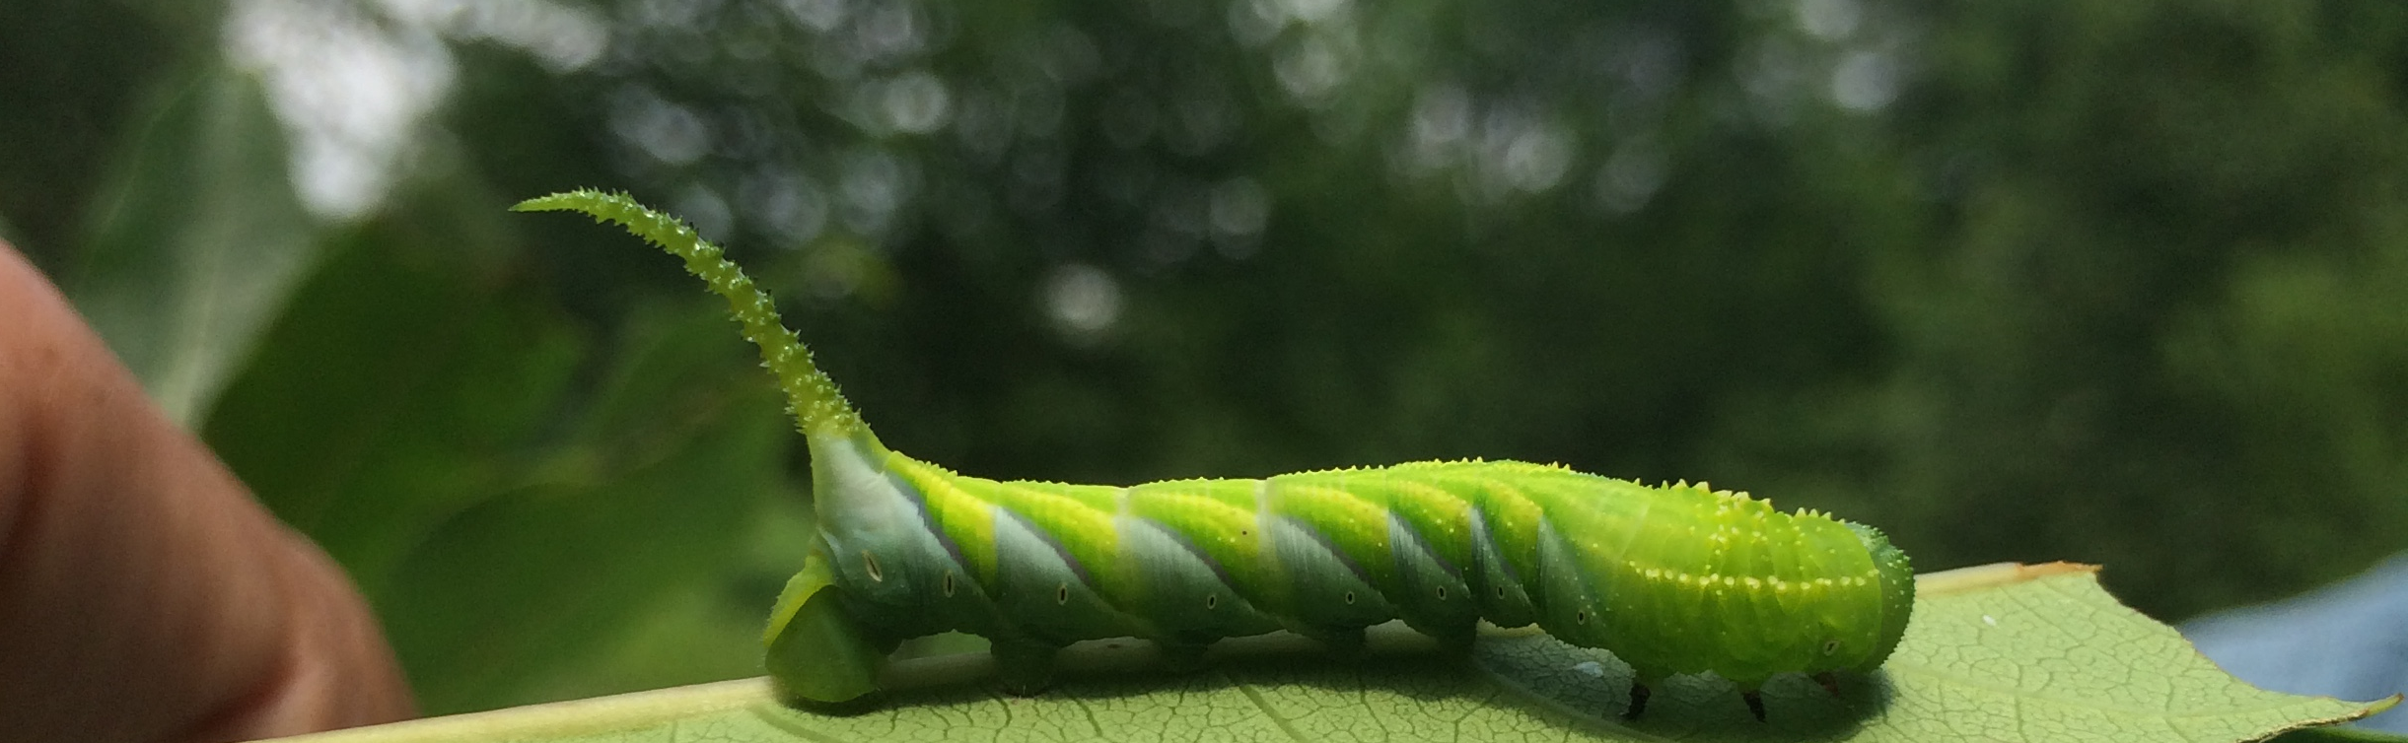
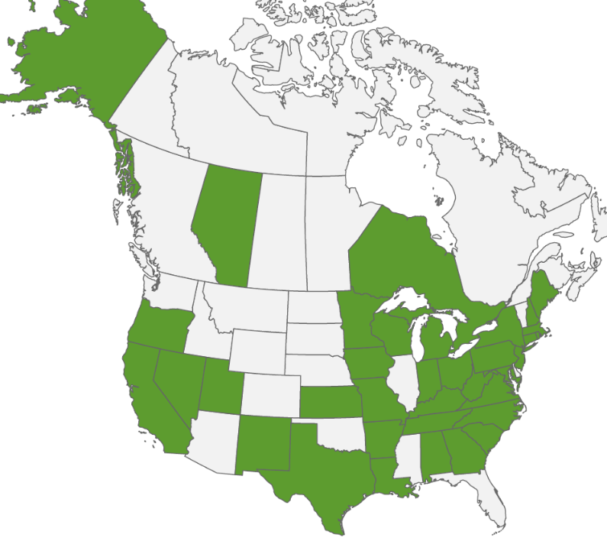






Caterpillars Count!
219
sites
1,776
data contributors
103K
branches surveyed
263K
arthropods observed

Slide 7
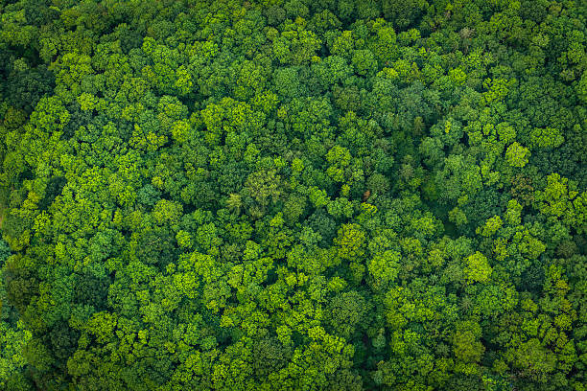
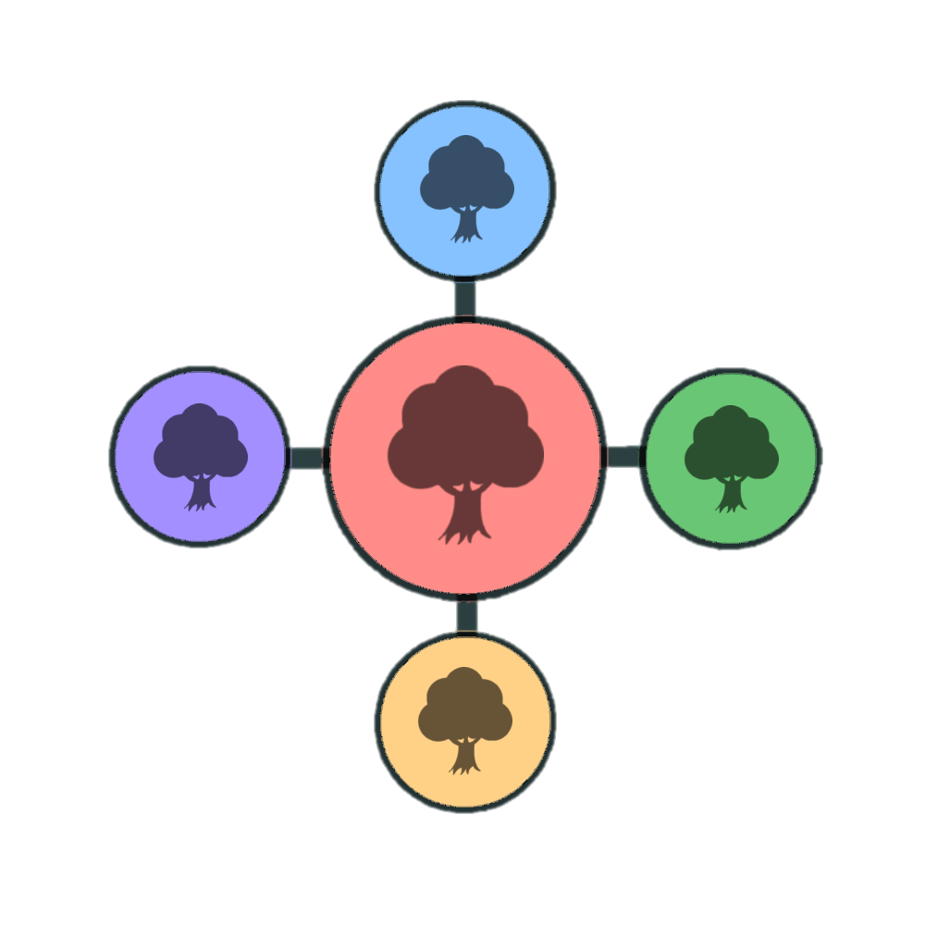

Survey site:
Our site has XX total survey branches
Survey branches occur in groups of 5 called “circles”
EXAMPLE:
Circle 2
Circle 6
Circle 4
Circle 1
Circle 3
Circle 5
Notes:
Modify to describe YOUR survey site.

Slide 8
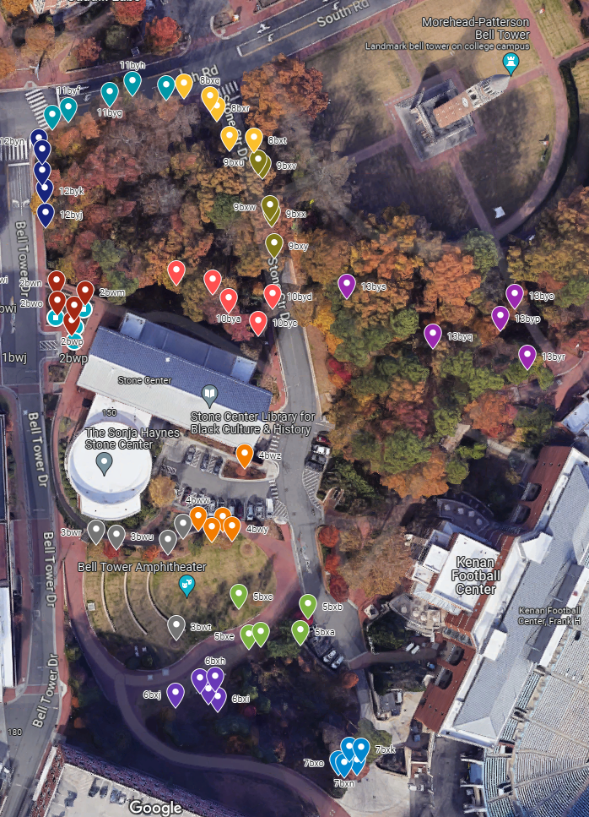
Survey site:
Consider providing a GoogleMap where you have pinned the locations of the individual survey branches
(Here they are color-coded by circle number)
Notes:
Optional

Slide 9
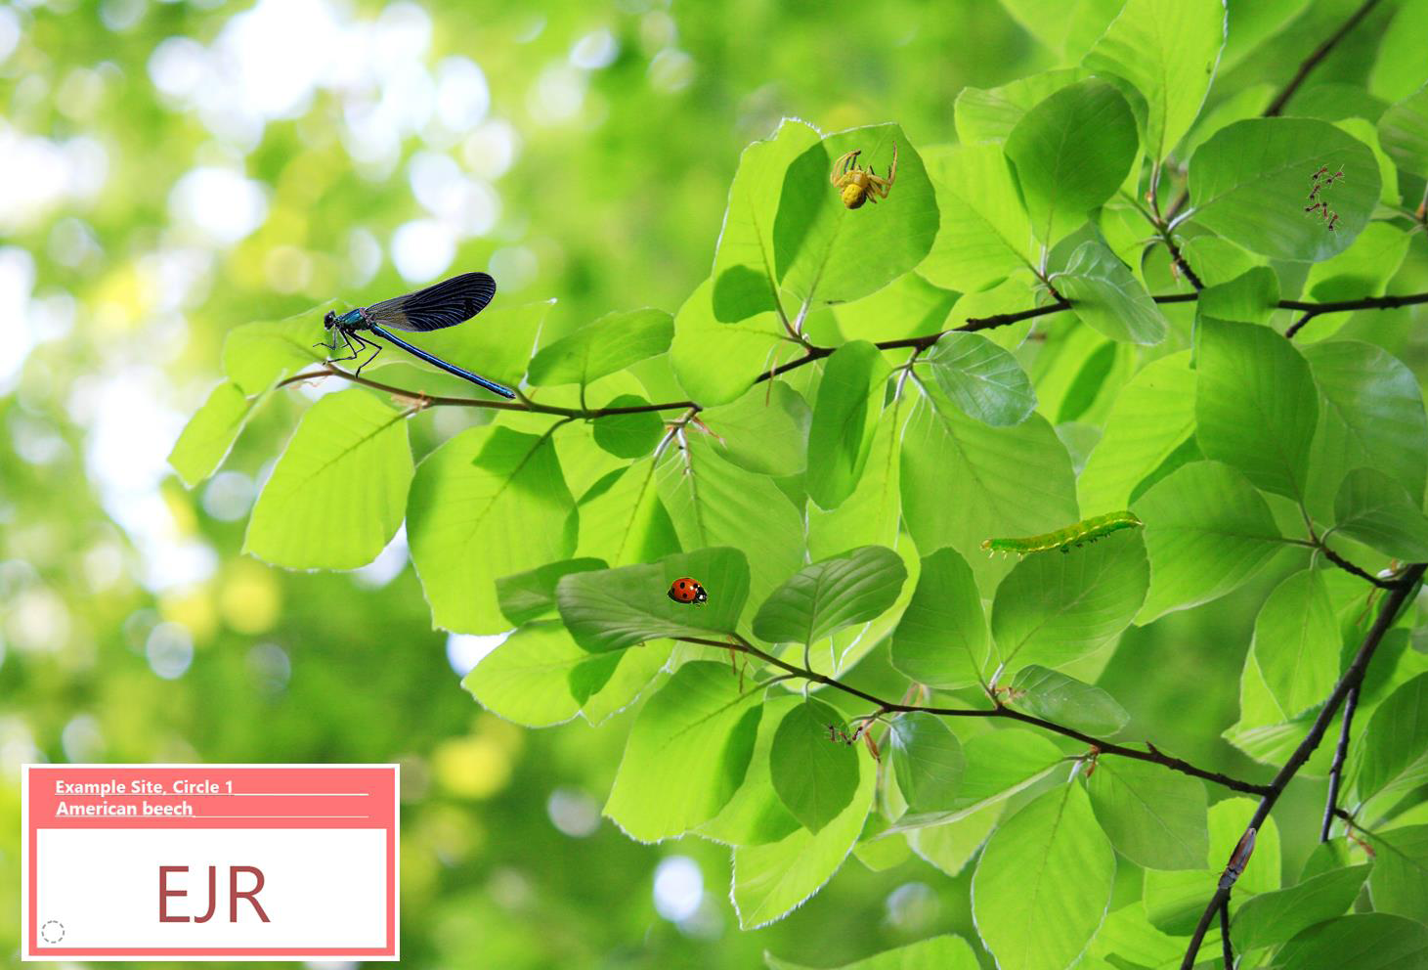
Each branch within a circle has a different colored tag Each tag has a unique 3-letter code
Survey site:
For this test branch, the password = test
Notes:
Have students practice using the free Caterpillars Count! mobile app using this test branch.
After downloading the app and creating an account, enter “EJR” under “branch survey code”. Students will then need to enter “test” as the site password. From there, they can explore the various data submission options, including clicking “Submit” at the end.
Students should not enter an actual survey code from your site just to practice.

Slide 10
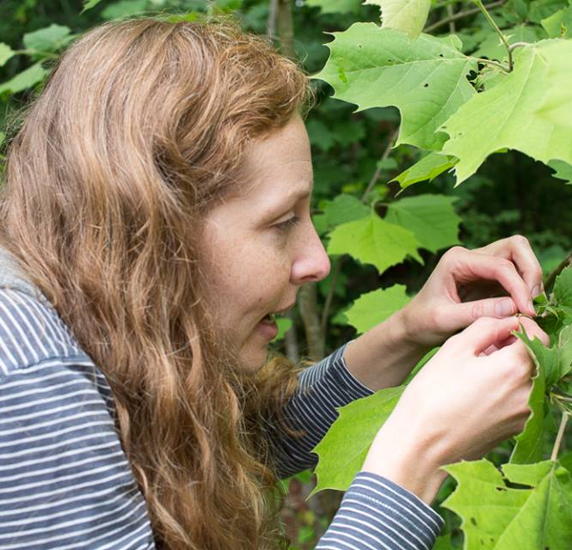
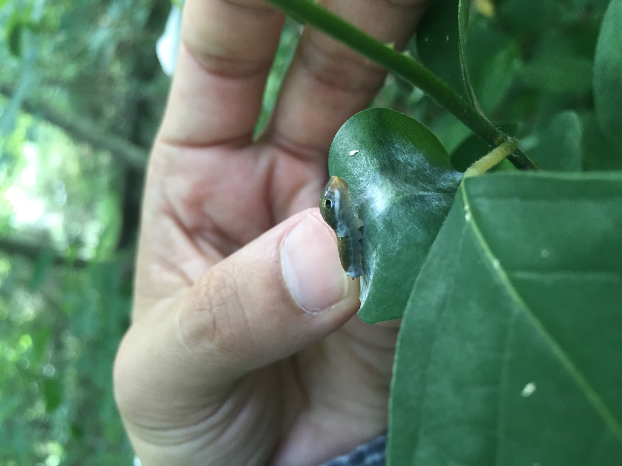
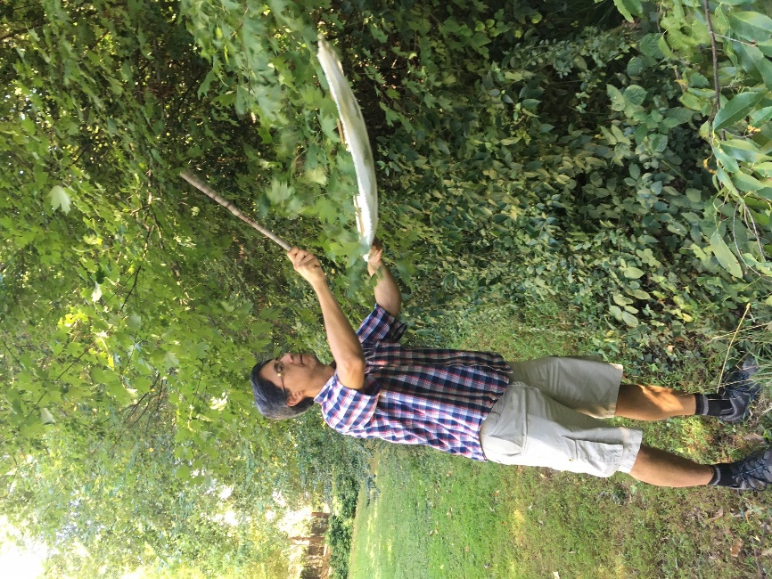
Conducting surveys
Visual survey
(~5 min each)
[video]
Beat sheet survey
(2-3 min each)
[video]
Notes:
Depending on which survey method you choose to implement with your class, you can have them watch the appropriate linked video.

Slide 11
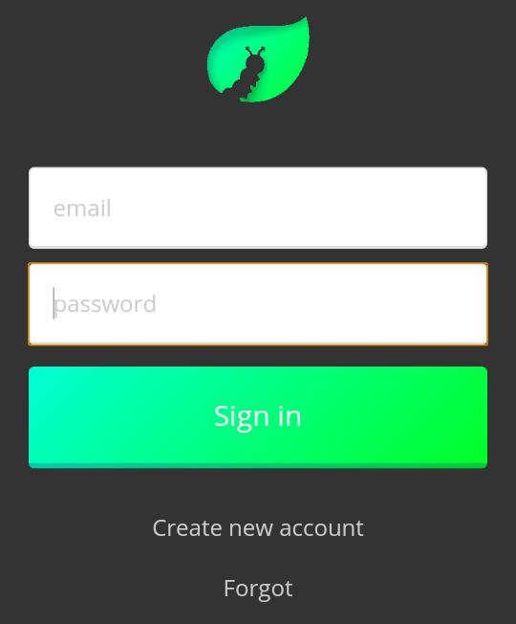
Create account / Sign in
Mobile app

Slide 12
Create account / Sign in
Mobile app
For this test branch, the password = test

Slide 13
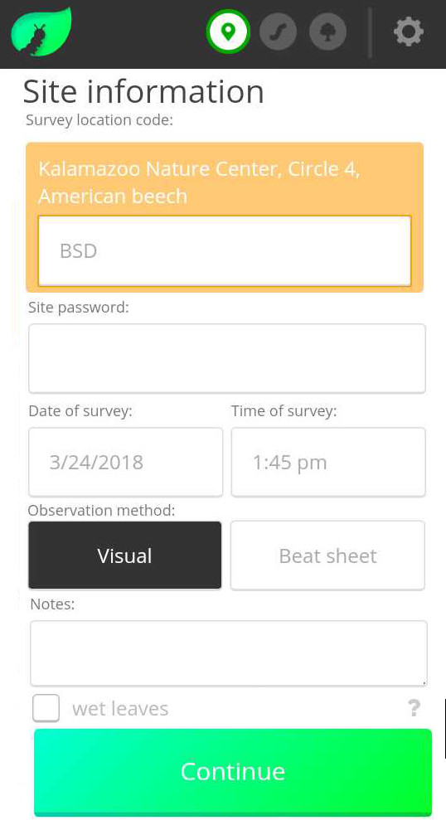
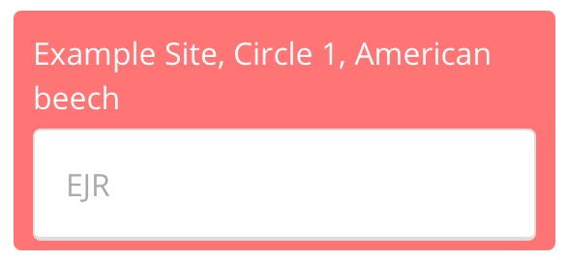
Create account / Sign in
Mobile app
Enter unique 3-letter survey code

Slide 14
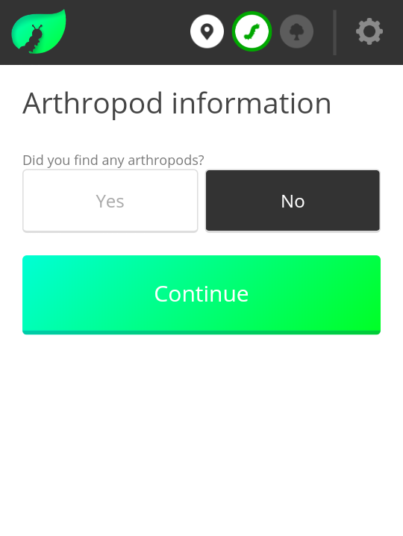
Mobile app

Slide 15
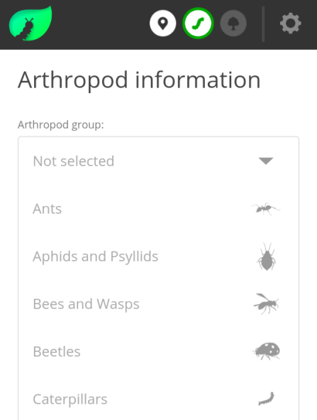
Mobile app

Slide 16
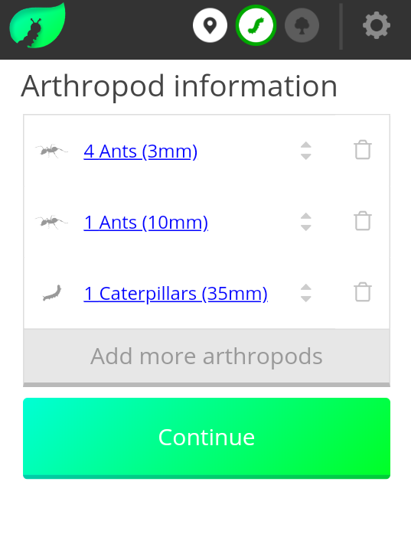
Mobile app

Slide 17

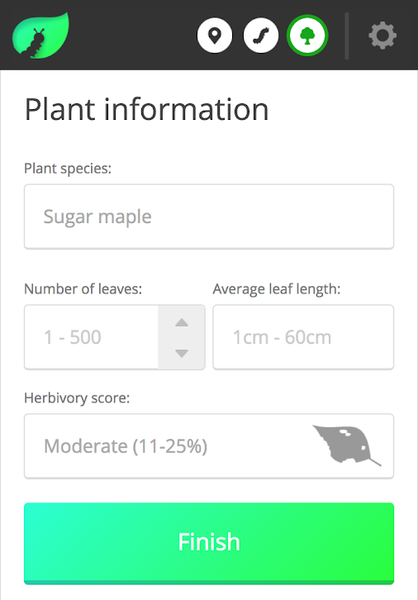
Mobile app

Slide 18
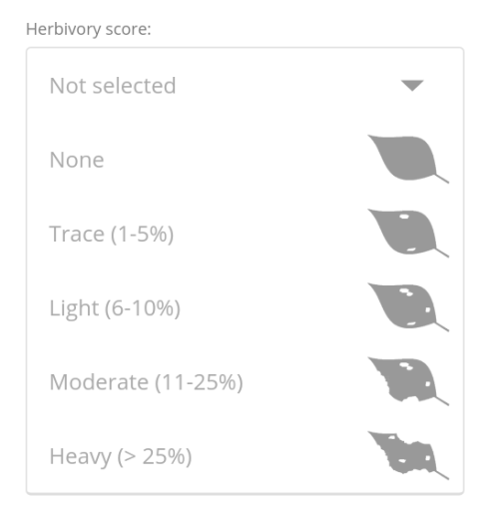
Mobile app

Slide 19
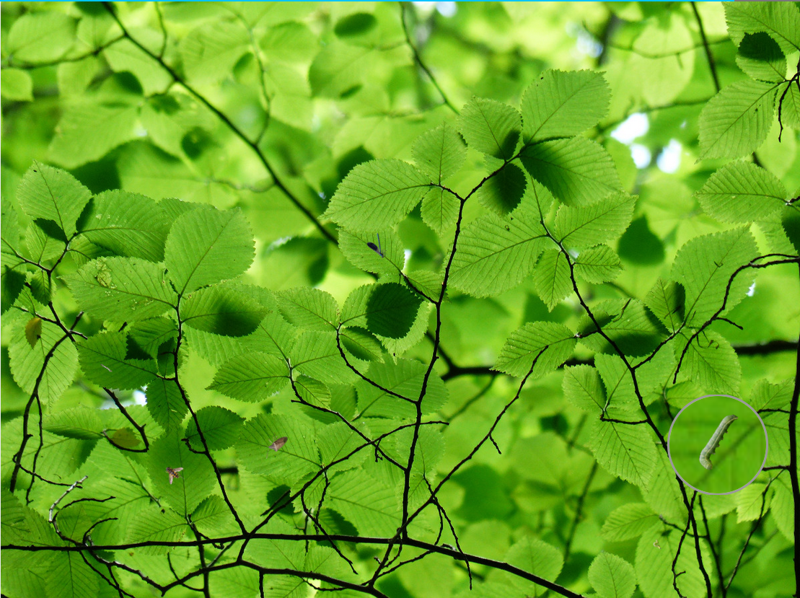
Virtual Survey
Play our virtual survey game to get practice
finding bugs on a branch
identifying them to order
estimating their length in millimeters
https://caterpillarscount.unc.edu/virtualSurvey

Slide 20
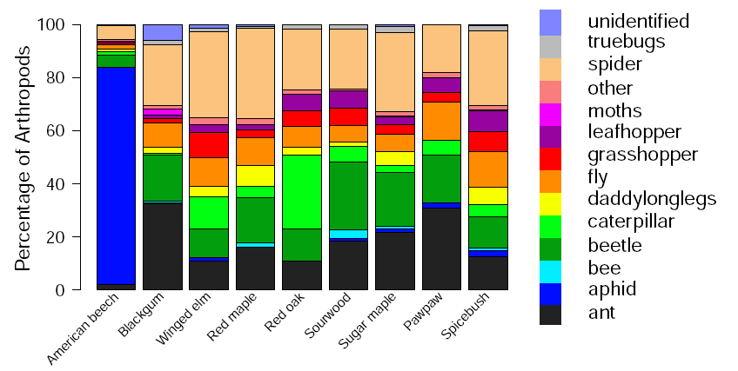
https://caterpillarscount.unc.edu/mapsAndGraphs
Data Visualization Tools
Resources page
https://caterpillarscount.unc.edu/resources

